Slide 1
Disability
⬆
V.M. Tamhane, Junior Consultant
Office of the Registrar General & Census Commissioner, India
New Delhi
6th February 2013

Slide 2
What is Disability?
⬆
‘Disability is a physical or mental condition/impairment that limits one or more major life activities substantially."

Slide 3
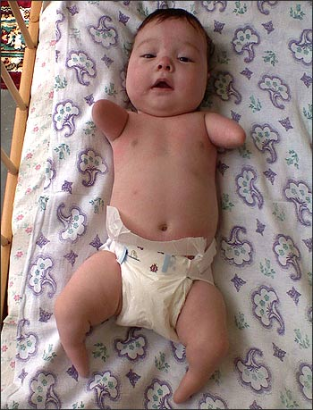
Where do Disabilities Come From
⬆
Some are born with disability. It is called congenital disability.
Disabilities are also acquired. t Acquired disabilities commonly arise from accidents, illness, working conditions that expose a person to an unhealthy environment.

Slide 4
Need for data on disability
⬆
Every human society has a few members who suffer from one or the other type of disability;
Data is required for making policies and programmes for the welfare of this dis-advantaged segment of the society;
Only Population Census which collects information about each individual can provide this information.

Slide 5
Important yet complex
⬆
Data important for the welfare of disabled;
Collection not simple;
Quality of census data on disability has been an issue in Census;
Many a factors are responsible;
Past experience testifies this.

Slide 6
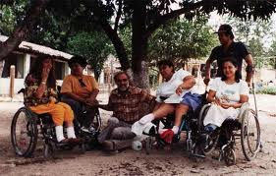
Brief History
⬆
The question on disability was canvassed in all the censuses since 1872 to 1931.
Due to the doubts expressed by the earlier Census Commissioners about the quality of data, the question on disability was not canvassed in the censuses of 1941,1951, 1961 and 1971.

Slide 7
⬆
Brief History contd.
1. 1981 being the year of disabled, the question on disability was re-introduced;
2. Results were not encouraging. There was large scale under enumeration of disabled;
3. Census Commissioner, 1981 Census observed that Population Census is not the right medium to collect information on disability;
The question on disability was not canvassed at the 1991 Census.

Slide 8
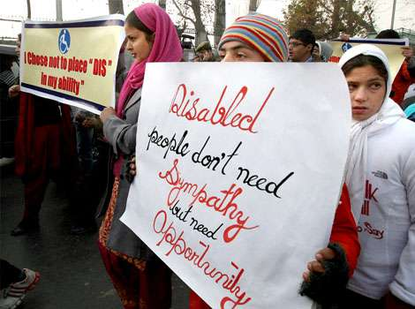
Brief History contd.
⬆
The question was re-introduced at 2001 Census;
Factors responsible were:
1. Enactment of persons with Disability Act, 1995;
2. Request made by the Union Ministries for collection of data on disabled;
3. Awareness among disabled and disability rights groups. They demanded inclusion of the question on disability in
Census Schedule.

Slide 9
Brief History contd.
⬆
2001 Census:
Information on five types of disability was collected:
-In Seeing
In Speech
In Hearing
In Movement
Mental

Slide 10
2001 Census Results in Brief
⬆
Type of disability | Persons | Males | Females
Total | 21,906,769 | 12,605,635 | 9,301,134
Seeing | 10,634,881 | 5,732,338 | 4,902,543
Speech | 1,640,868 | 942,095 | 698,773
Hearing | 1,261,722 | 673,797 | 587,925
Movement | 6,105,477 | 3,902,752 | 2,202,725
Mental | 2,263,821 | 1,354,653 | 909,168
The disabled comprised 2.13 percent of the total population of India.

Slide 11
Percentage distribution by type of disability Census 2001
⬆
2001 Census results on disability were considered as under enumeration

Slide 12
⬆
Approach and measures taken at Census 2011

Slide 13
2011 Census
⬆
At the Census 2011 our objective was to ensure complete and accurate coverage of all disabled without omission.
To begin with, following impediments were identified which together contribute to less returns:
Definitional aspect: Simple and comprehensible definitions required
Training aspect- imparting training on a sensitive issue like disability to 2.7 million Census functionaries is a difficult task,
Mindset of Public - certain types of disabilities treated as stigma
General tendency to withhold information: particularly in the case of infants, unmarried females and elderly.
Perception and response of the respondent is final.

Slide 14
2011 Census-Finalization of question-the definitional aspect
⬆
A field Trial of the question on disability was conducted to ascertain the areas which required improvement and to devise strategy to overcome these;
Deliberations were held with all stakeholders in Government and those working for the welfare of disabled.
There after the question and definitions were finalized based on the recommendations/suggestions which were found to be acceptable for the purpose of Population Census.

Slide 15
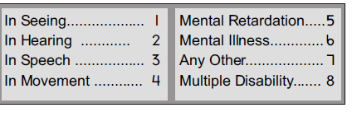
2011 Census-the question on disability
⬆

Slide 16
2011 Census-Important features of the question on disability
⬆
Categories of disabilities increased from five at 2001 Census to eight at the Census 2011;
Category of ‘Any Other ‘included to ensure complete coverage;
Mental Retardation and Mental Illness treated as separate disabilities
Provision to record maximum three types of disabilities under Multiple disability provided
All types of disabilities listed in PWD Act, 1995 and National Trust Act, 1999 covered;
The placement of question has been changed. Brought forward from Q.-15 at 2001 Census to Q. – 9 at Census 2011,

Slide 17
2011 Census-Training
⬆
Intensive Training programme was drawn;
National Trainers and Master Trainer Facilitators were imparted intensive training on the disability question,
Were trained to motivate enumerators,
One of the important features of training was the partnership with NGOs working for the welfare of disabled.

Slide 18
⬆
Partnership with Disability Sector
A- NGOs working for the welfare of disabled were involved in training of Census functionaries at National , State and District level
B- Created a special module for training on the question on disability. This was used across the country,
c- Role models from disability groups were invited in training classes to motivate and sensitize Census functionaries.
D- Created awareness across the country among the disabled and general population to respond to the question on disability and provide correct information to Census Enumerators,

Slide 19
2011 Census-Publicity on disability
⬆
Special audio/ video spots prepared in 12 languages for awareness generation,
The video clip to be telecast on all popular TV channels has actual disable persons acting in this,
Wide publicity through electronic and print media proposed. The general theme film too has a special component on disability,
Special write up on disability prepared and put in the media kit to be made available to media persons,
various other innovative modes of publicity like rallies etc. proposed.

Slide 20
Publicity
⬆
Special E-learning module prepared to show as to how to approach and extract information from respondents,
Leaflet on disability was prepared and distributed among media persons
Seminars and workshops were held at State level to create awareness,
Banners and Posters on disability displayed,
Rallies and other events organized
At Census Directorate level many an innovative modes of publicity were used

Slide 21
Print advertisements
⬆

Slide 22
⬆

Slide 23
Disability in news
⬆

Slide 24
Issues
How to devise appropriate question on disability and prepare simple instructions
How to evolve appropriate training modules to inspire and motivate Census Enumerators to canvass the question on disability without hesitation ;
How to inform the masses about the importance of disability statistics to the government;
How to reach out to the general public to report the disability status correctly and accurately and to overcome the culture barriers,
How to create an atmosphere where enumerator is allowed to work with dignity

Slide 25
What should be done
Decide the types of disabilities on which information is required
Consult all stakeholders before finalizing the question and the definitions,
Keep the question and the definitions simple
Enumerators should be adequately trained to canvass the question with caution. Sensitivity of the respondent should not be hurt
Also remember, too much stress on sensitive nature of the question will discourage the Enumerators to canvass the question
Motivate Enumerators to canvass the question on disability and to ensure that Infants, Girls of Marriageable age and elderly are not missed out

Slide 26
What should be done
Engage more and more NGOs/organizations/volunteers to create awareness.
There role should be defined
Target rural areas more for creating awareness
Enumerators should first establish rapport with the respondent before asking question on disability
Inform the purpose of collection of information and the use to which this is going to be put
Seek public cooperation through messages by celebrities, local heros
Devise a publicity campaign to educated public about the need for data on disability.

Slide 27
Conclusion
⬆
The Census data on disability would give a broad idea about the prevalence of disability in the country up to the lowest administrative level.
It will help the Government to plan policies, allocate adequate resources and provide support services for persons with disabilities and their families.
It will help in taking adequate measures to provide equal opportunities in education and employment for people with disabilities.
Would provide platform for further detailed investigations by other agencies;

Slide 28
Thank You
⬆

